Slide 1

Luxury Tax Basics Simulation
Track 101 -M1L2
Bow Sports Capital

Slide 2

Initial Decision Point
Cap: $136M | Budget Limit: $150M | Current Payroll: $134M | Over: $0M | Total Spend: $134M | Wins: 40
Cap: $136M | Budget Limit: $150M | Current Payroll: $134M | Over: $0M | Total Spend: $134M | Wins: 40
Target: Reach at least 46 Wins without spending more than $150M total.
Evaluate your first GM decision:
Sign Star Player
Add Depth
Promote Rookie

Slide 3

Scenario A
Cap: $136M | Payroll: $146M | Over: $10M | Tax: $10M | Total Spend: $156M | Wins: 44
The new star electrifies fans and boosts ticket sales.
But the deal pushes you $10M over the $136M line, triggering a dollar-for-dollar tax.
That’s $20M in real cost for a single move
Choose your next step:
Cut Salary
Add Depth
Coach Boost
PR Hype

Slide 4
Scenario B
Payroll: $142M | Over: $6M | Tax: $6M | Total Spend: $148M | Wins: 42
Depth moves strengthen your bench but start pushing into tax territory. Each new signing doubles its cost. The owner warns: “$150M is the ceiling.”
Choose your next move:
Add Star
Promote Rookie
Coach Boost
Cut Salary

Slide 5

Scenario B1
Payroll $149M | Over $13M | Tax $10M | Total Spend $159M | Wins 43
Adding a star player boosts scoring and fan interest, but the new contract pushes payroll above the target.
Ownership calls to remind you that the luxury tax penalty multiplies every dollar past $150M.
Cut Salary
Coach Boost

Slide 6
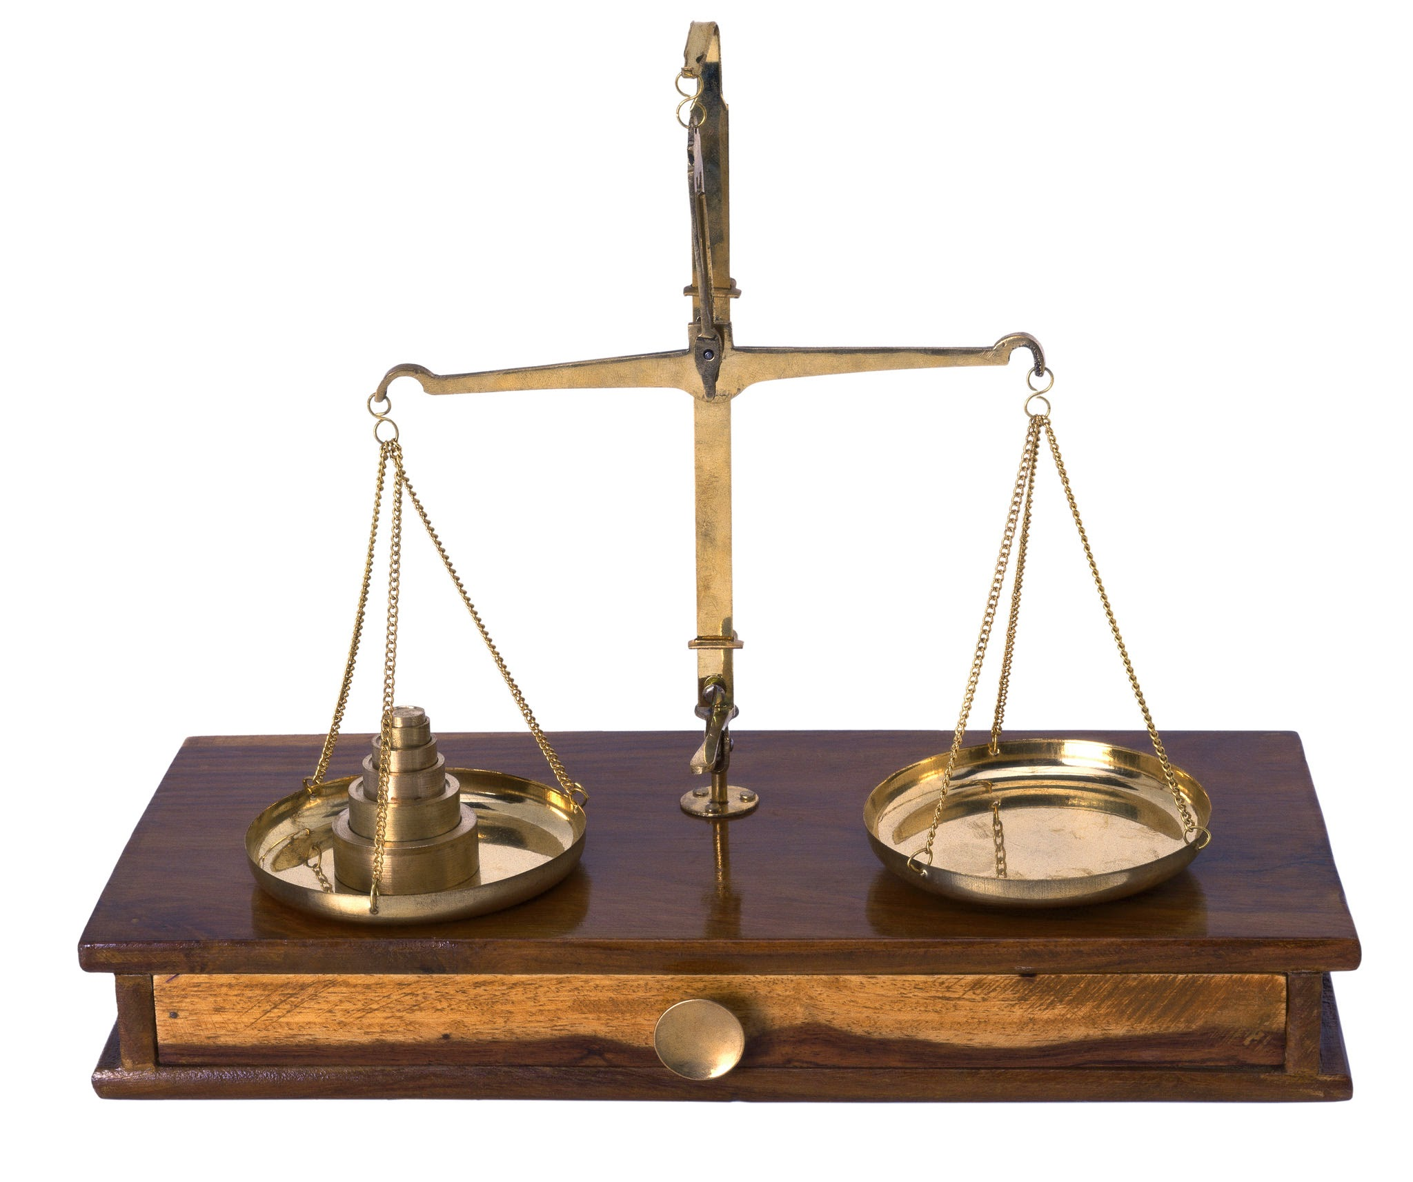
Scenario B3B
You stayed within the budget but fell short of the 46-win target.
Smart spending alone is not enough. Try a new sequence to balance both cost and performance.
Restart Simulation

Slide 7
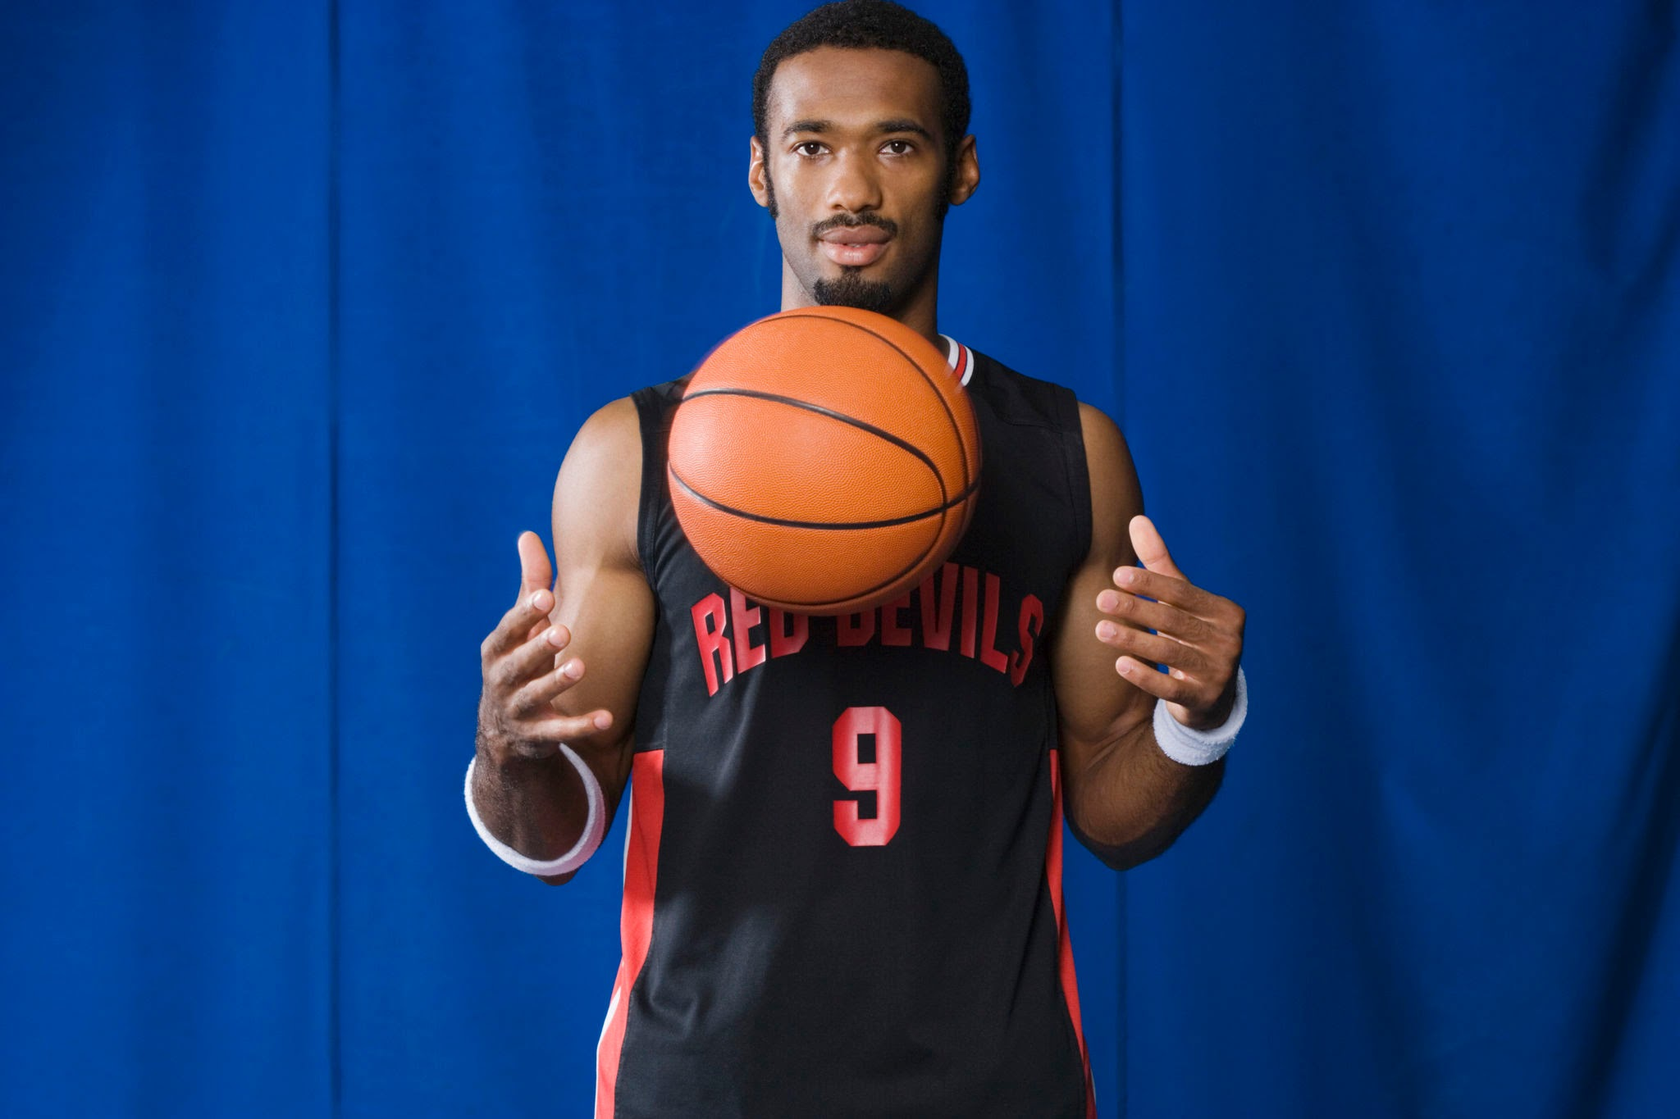
Scenario B2 - Promote Rookie
Cap 136 | Budget 150 | Payroll 142 | Over 6 | Tax 6 | Total Spend 148 | Wins 44
A young player steps up and keeps costs flat.
Your team looks balanced and confident.
Coach Boost
Cut Salary
Add Star

Slide 8

Scenario C
Payroll: $136M | Over: $0M | Tax: $0M | Total Spend: $136M | Wins: 41
You’ve stayed exactly at the tax line, which is exactly the perfect position.
You pay no penalty, but every next move risks triggering the tax. Ownership encourages caution.
Choose your next move:
PR Hype
Add Depth
Add Star
Cut Salary
Image Source

Slide 9

Scenario C1- PR Hype
Payroll $136M | Over $0M | Tax $0M | Total Spend $136M | Wins 42
A successful media campaign boosts morale and public interest.
Ticket sales rise, and the team responds with improved effort on the court.
Add Depth
Add Star
Cut Salary

Slide 10

Scenario C2
Payroll $140M | Over $4M | Tax $4M | Total Spend $144M | Wins 44
Adding key rotation players strengthens the bench and keeps your stars fresh.
The team gains momentum, though spending edges into light tax territory.
Choose your next move:
Coach Boost
Add Star
Cut Salary
Owner Rally

Slide 11

Scenario C3
Payroll $145M | Over $9M | Tax $9M | Total Spend $154M | Wins 45
The new star drives a surge in wins and fan engagement, but the move flirts with the $150M budget limit.
Ownership calls for restraint moving forward.
Cut Salary
Coach Boost
Add Depth

Slide 12

Scenario C4
Payroll $130M | Over $0M | Tax $0M | Total Spend $130M | Wins 39
You slash payroll to avoid any tax risk. The financial books look great, but the on-court product struggles and fans lose interest.
Coach Boost
Add Depth
Owner Rally

Slide 13
Scenario A1
Cap: $136M | Budget Limit: $150M | Current Payroll: $140M | Over: $4M | Total Spend: $144M | Wins: 43
Your salary cuts reduce payroll and ease the tax burden.
Performance dips slightly, but the owner appreciates your effort to stay disciplined.
Choose your next step:
Coach Boost
Promote Rookie
Add Depth

Slide 14
Scenario A1R - Promote Rookie
Cap 136 | Budget 150 | Payroll 142 | Over 6 | Tax 6 | Total Spend 148 | Wins 47
The rookie’s breakout adds energy at low cost.
Your payroll stays within reach of the limit, and the owner is impressed.
Owner Rally

Slide 15
Scenario A1C-Coaching Boost
Cap 136 | Budget 150 | Payroll 140 | Over 4 | Tax 4 | Total Spend 144 | Wins 46
Coaching improvements raise efficiency and chemistry.
The roster now performs like a contender without new spending.
Owner Rally

Slide 16
Scenario B3
Cap: $136M | Budget Limit: $150M | Current Payroll: $142M | Over: $6M | Tax: $6M | Total Spend: $148M | Wins: 45
Strategic adjustments improve defense and teamwork.
Efficiency climbs without raising payroll.
Owner Rally
Promote Rookie
Cut Salary

Slide 17
Scenario B4
Cap 136 | Budget 150 | Payroll 135 | Over 0 | Tax 0 | Total Spend 135 | Wins 40
You trim payroll to clear the tax entirely.
The owner is pleased, but the roster loses depth and your win total drops.
Coach Boost
Add Depth
Owner Rally

Slide 18

Scenario A2
This action would push the Total Spend beyond the $150M limit.
Action is not permitted by ownership.
Return to Previous Decision
Image Source

Slide 19
Scenario C2B
This action would push the Total Spend beyond the $150M limit.
Action is not permitted by ownership.
Return to Previous Decision
Image Source

Slide 20
Scenario C3C
This action would push the Total Spend beyond the $150M limit.
Action is not permitted by ownership.
Return to Previous Decision
Image Source

Slide 21
Scenario C2B
This action would push the Total Spend beyond the $150M limit.
Action is not permitted by ownership.
Return to Previous Decision
Image Source

Slide 22
Scenario B2C
This action would push the Total Spend beyond the $150M limit.
Action is not permitted by ownership.
Return to Previous Decision
Image Source

Slide 23

Scenario A3
Certain actions, like 'PR Hype', are only effective when the payroll is at or below $136M.
Return to Previous Decision

Slide 24

Scenario B1B
Certain actions, like Coach Boost, are only effective when the payroll is at or below $136M.
Return to Previous Decision
Image Source

Slide 25
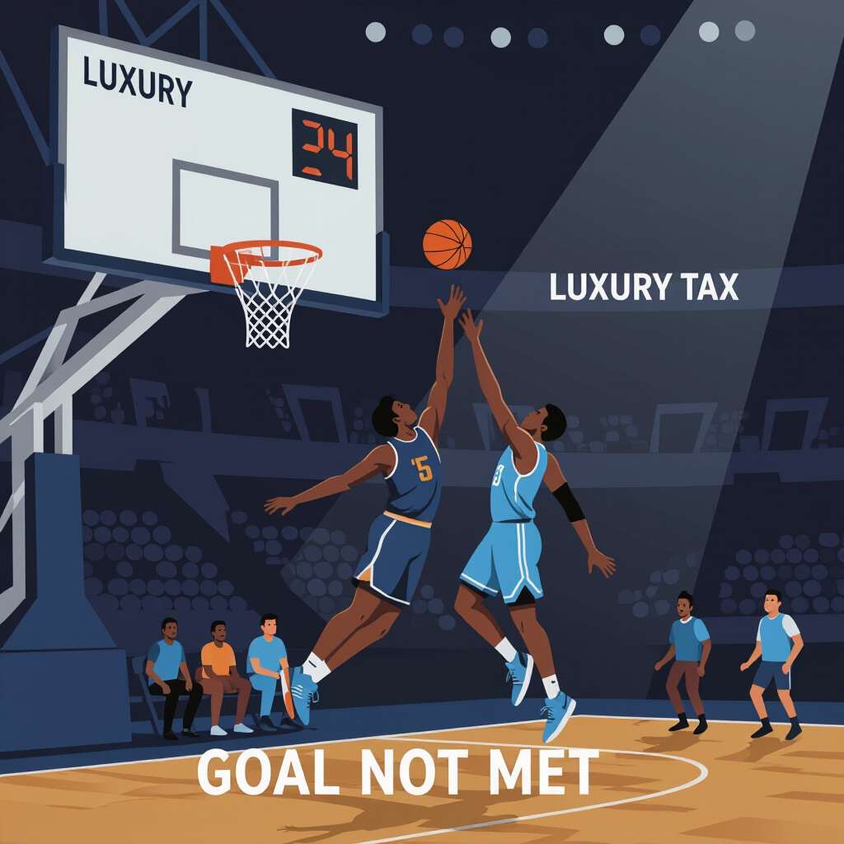
Scenario B4A
You managed the budget but did not achieve the required win target.
Consider alternative strategies or Restart Simulation
Image Source

Slide 26
Scenario C4A
You managed the budget but did not achieve the required win target.
Consider alternative strategies or Restart Simulation
Image Source

Slide 27
Final Scenario A (Victory)
Cap: $136M | Budget Limit: $150M | Payroll: $142M | Over: $6M | Tax: $6M | Total Spend: $148M | Wins: 47
You found the right balance. A strong roster and controlled tax costs deliver a playoff berth.
Claim Code: CLAIM-A47WIN

Slide 28

Scenario B Final
Cap: $136M | Budget Limit: $150M | Payroll $142M | Over: $6M | Tax: $6M | Total Spend: $148M | Wins: 46
You balanced spending, depth, and coaching perfectly.
The team reaches 46 wins while staying under the $150 million limit.
Ownership approves a long-term plan built on efficiency.
Claim Code: CLAIM-B46WIN

Slide 29

Final Scenario C (Victory)
Cap: $136M | Budget Limit: $150M | Payroll $142M | Over: $6M | Tax: $6M | Total Spend: $148M | Wins: 47
You built from within, added depth at the right time, and managed tax pressure perfectly.
Claim Code: CLAIM-C47WIN

